Slide 1
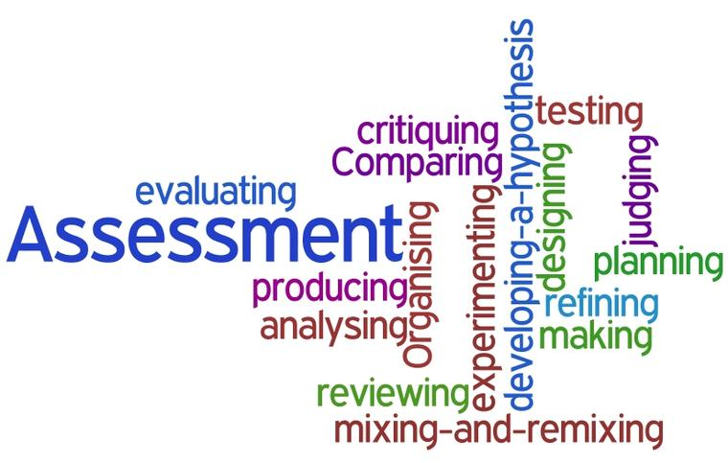
NAPLAN
Parent Information session
Presented by Sue White 2023

Slide 2
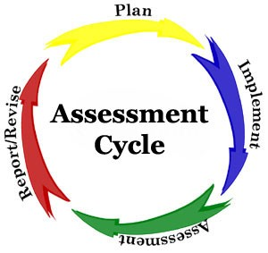
NAPLAN
National
Assessment
Program
Literacy
And
Numeracy

Slide 3
NAPLAN
WHO ?- Year 3,5,7 and 9 students in Australia
Exemptions
WHEN ?- began in 2008
an annual assessment
undertaken 15th -27th March.
WHERE ?- at each school location

Slide 4
NAPLAN
What is assessed?-
Reading
Writing
Language Conventions (Spelling, Grammar and Punctuation)
and
Numeracy.

Slide 5
NAPLAN
WHY?
information against national standards.
longitudinal tracking of student achievement and school progress,
data for improving the literacy and numeracy achievements of students.

Slide 6
NAPLAN
NAPLAN results sent to schools and then distributed to parents
Reports are available to schools on the NAPLAN website.

Slide 7
NAPLAN
NAPLAN is not a pass or fail type test
It is not expected that all students will be able to answer all questions correctly.
Individual student performance is shown on a National Achievement scale for each test.

Slide 8

NAPLAN
is a SNAPSHOT
of student achievement on one particular day

Slide 9
NAPLAN
GWSPS uses the data to
Examine trends over years
Compare results against state and national results
Compare groups of students….gender, EAL, same group etc.
Examine teaching practices

Slide 10

NAPLAN
Classroom teachers and the data
Examine whole school results
Look at individual student results
Compare writing moderation marks with teacher judgement
Examine classroom teaching practices

Slide 11
NAPLAN
NAPLAN does not replace, but rather compliments, assessments given by your child's classroom teacher throughout the year.
NAPLAN tests are one aspect of the school’s assessment and reporting process, and do not replace the extensive, ongoing assessments made by teachers about each student’s performance.

Slide 12
NAPLAN
GWSPS and NAPLAN preparation
NAPLAN assesses literacy and numeracy skills that students are already learning through the school curriculum.
Students are made familiar with the test formats and will provide appropriate support and guidance.
Excessive preparation is not useful and can lead to unnecessary anxiety.
If you have any questions about your child's preparation for NAPLAN, you are encouraged to make a time to speak with their teacher.

Slide 13
NAPLAN
Assessment format
multiple-choice The assessments are adaptive resulting in students receiving different questions
completed on a laptop through a locked-down browser app installed on school computers
writing task requires students to write (Year 3) type (Year 5) a text in response to a persuasive or narrative writing prompt

Slide 14
Frequently asked questions
Who will administer the tests?- each school
Who will mark the tests?- ACARA staff and computers
Where can I get more information?-see info in future slides
What is narrative writing? –writing a story
What is persuasive writing?- writing an argument

Slide 15
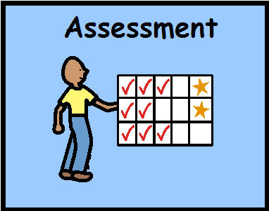
NAPLAN
Look at test examples on the NAPLAN information website

Slide 16
NAPLAN
Preparation for NAPLAN assessments
Early nights
Calm mornings
On time at school
Encouraging and supportive family

Slide 17

NAPLAN
Be supportive of your child before during and after these assessments.

Slide 18
NAPLAN
Videos
What is NAPLAN?
Why is NAPLAN valuable?

Slide 19
NAPLAN
If your child’s results are either higher or lower than you expected, you should discuss these results with their teacher.

Slide 20
NAPLAN
Interpreting your child’s report.
How to Interpret NAPLAN Report

Slide 21


NAPLAN
Please speak to class teacher if you have any further questions.

